Slide 1

Never Get Lost Again:
Learn to Navigate and Use
Your Smartphone GPS and
Other Exciting Mapping Apps
APPs
FOR GPS
Chad Sperry, GIS Center
Donghee Koh, PowerPoint Extraordinaire

Slide 2
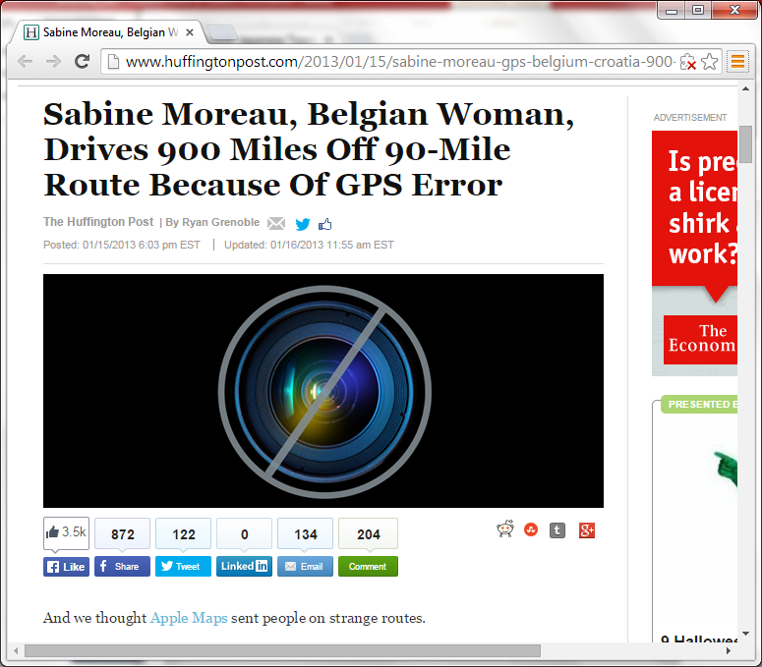

Slide 3


Slide 4
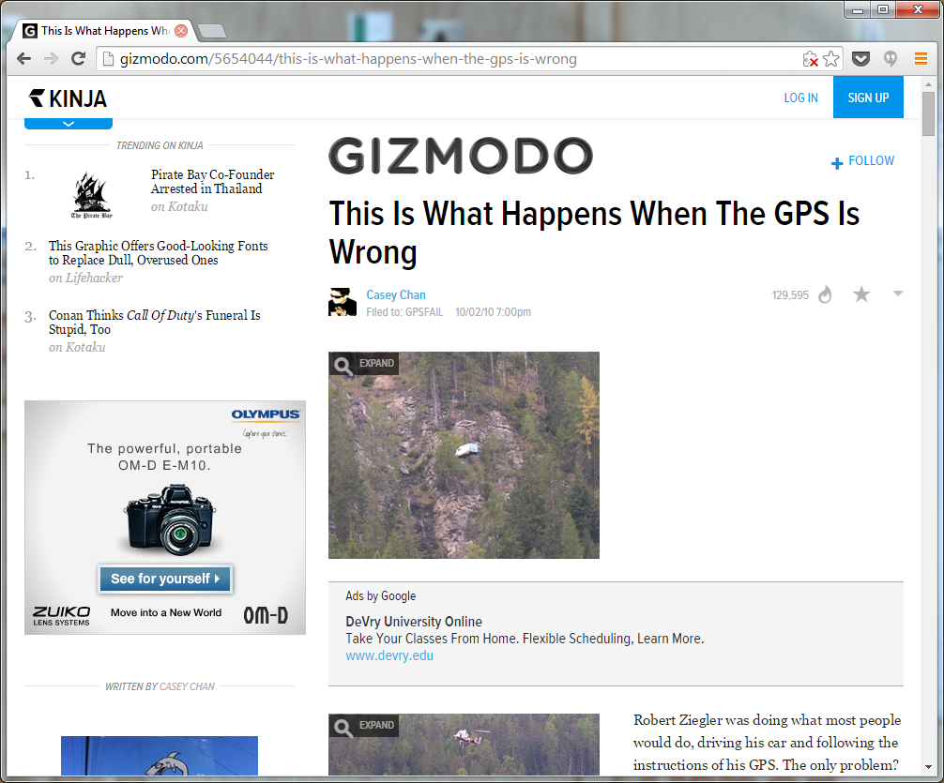


Slide 5
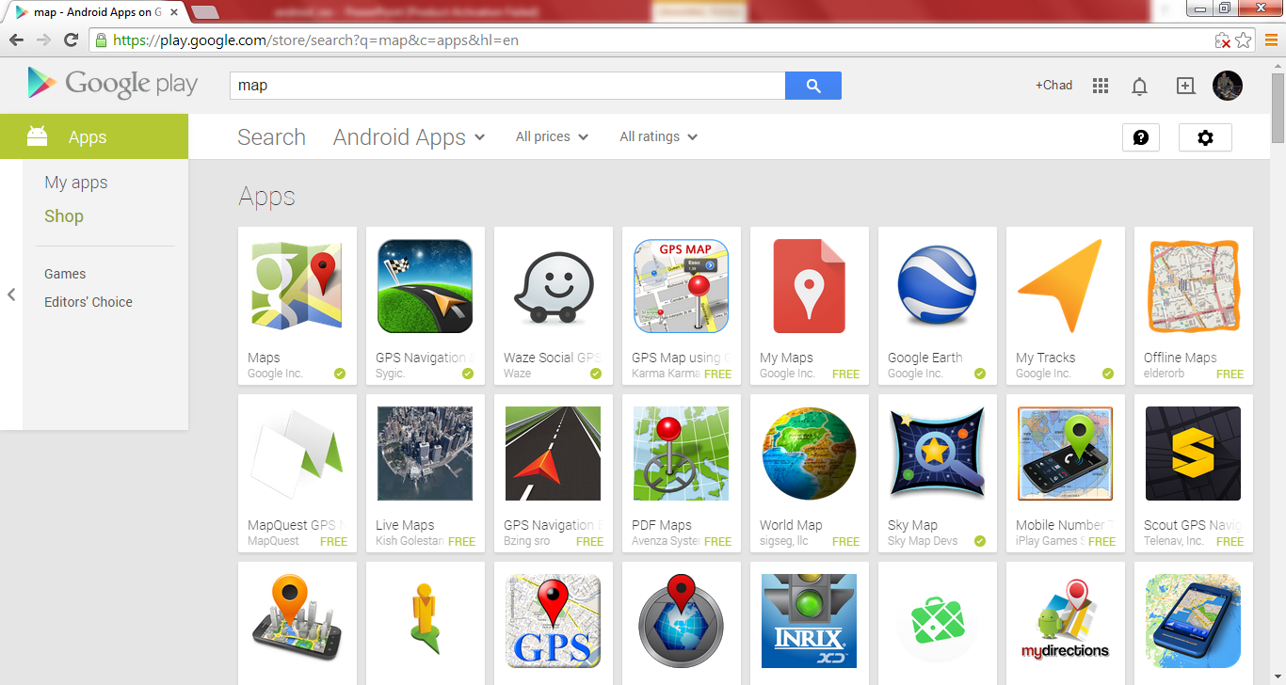
Google Play
https://play.google.com/store/search?q=map&c=apps&hl=en

Slide 6
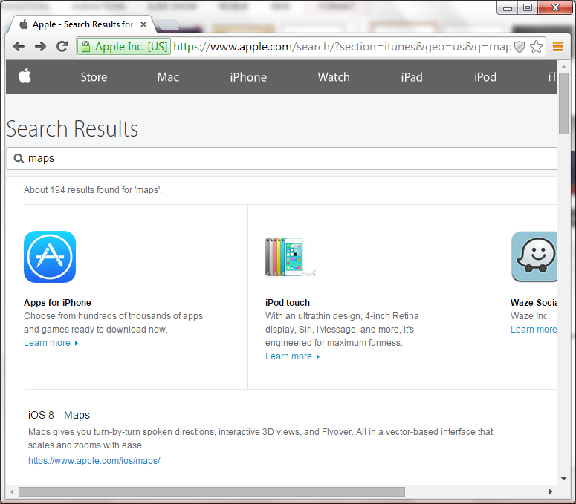
Apple App Store

Slide 7
Mobile Location
Varies with device manufacturer and carrier
Older devices may not be supported
Accuracy
Indoor Use

Slide 8

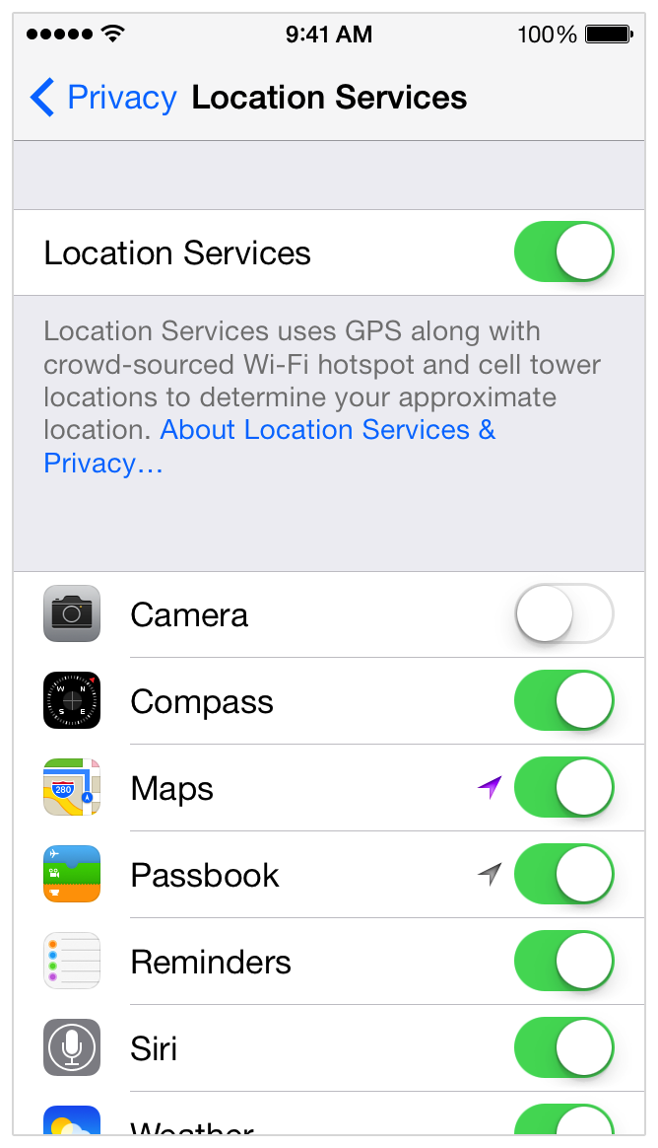
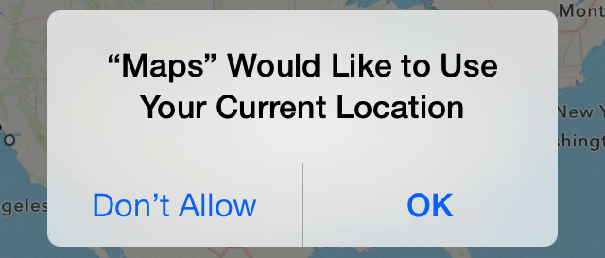

Location

Slide 9

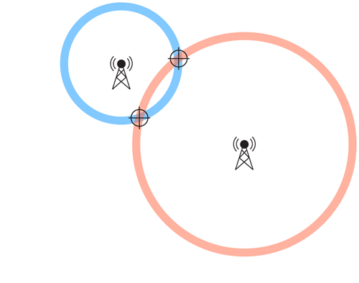
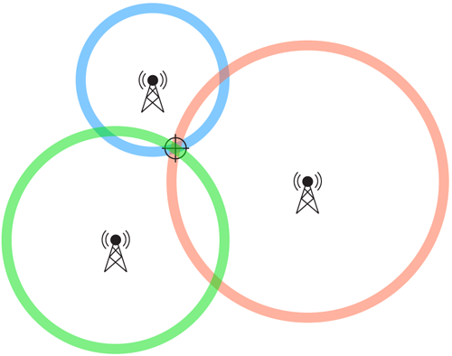
Location - Cell Towers/Network
Course Positioning

Slide 10

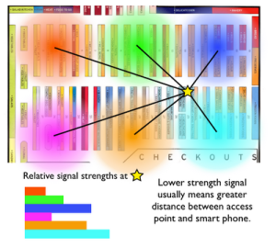
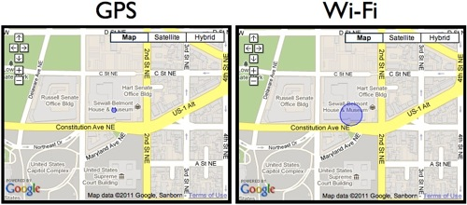
Location – WiFi
Mapped using our smartphones and GPS
Quick, not accurate (improving)

Slide 11

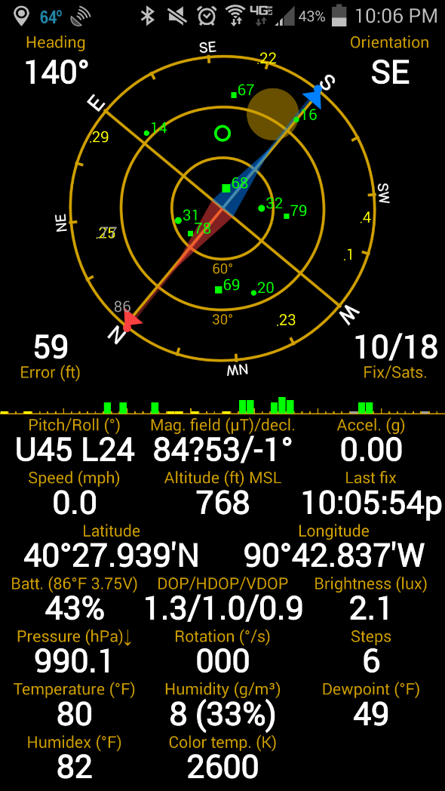
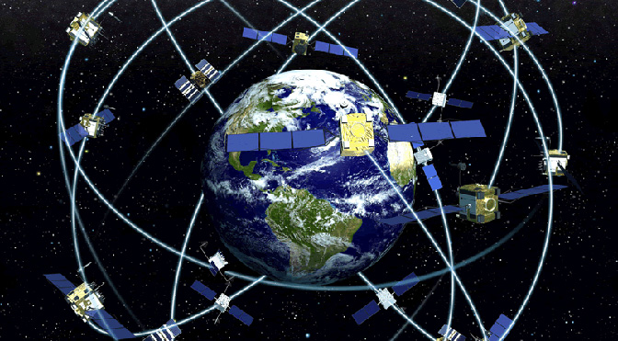

Location – GNSS (GPS)
Accurate
High Battery Consumption
Not Reliable Indoors

Slide 12
Types of Apps
On Road – Vehicle Navigation
Off Road – Hiking, Topo
Recording Tracks and Waypoints
Status – GPS Availability
Specialty (workout, golf, gas buddy, speedometer, Google Now)
General Location –
  Facebook (check-in)
  Weather (forecast)
  Glympse (share location)

Slide 13
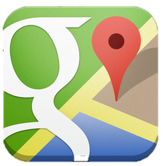


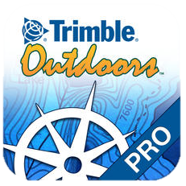
Apps for Both
Google maps
Waze
Gaia
Trimble
Navigator
Voice-guided nav for driving, biking, or walking. Live traffic conditions with automatic rerouting. Tells which lane to be in for a turn. Street view.
Community-based traffic and navigation app. Live routing based on user reports. Finds cheapest gas station on route.
Record tracks, waypoints, and take geo-tagged photos. Display NEXRAD radar, track data, and Gaia POI data from webpages. Import and export GPX/KML files.
Offline maps for your iPhone. Save topo maps and aerial images on your iPhone then go anywhere. Trimble Outdoors Navigator does not need a cell or data connection.

Slide 14
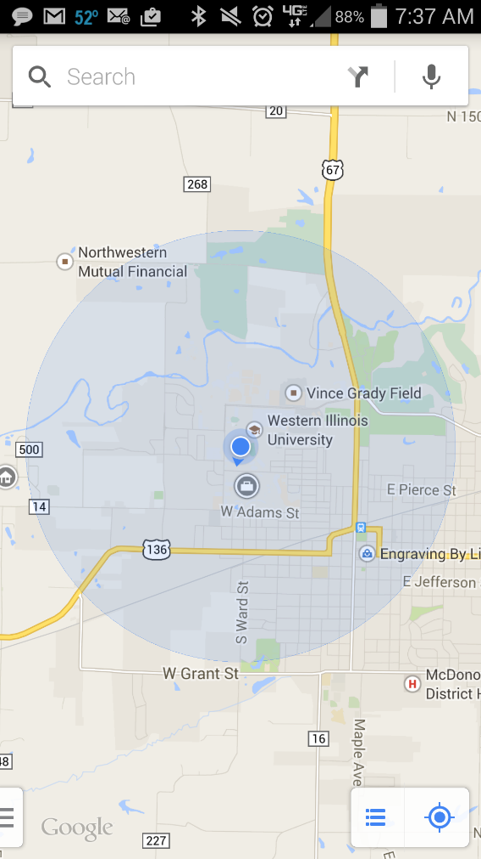
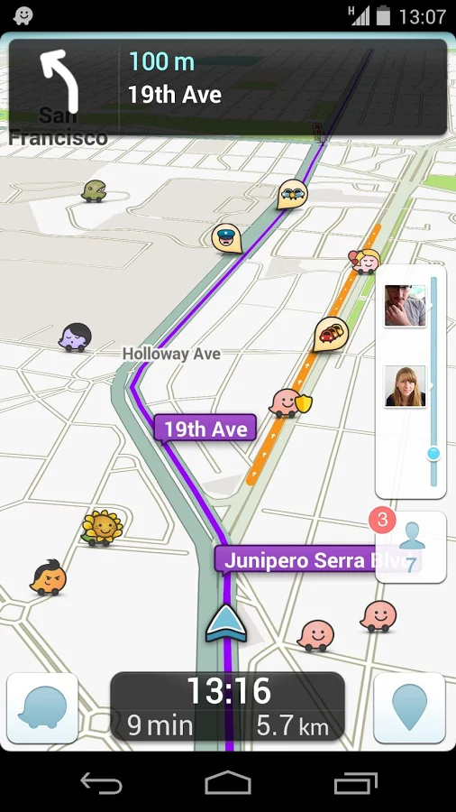
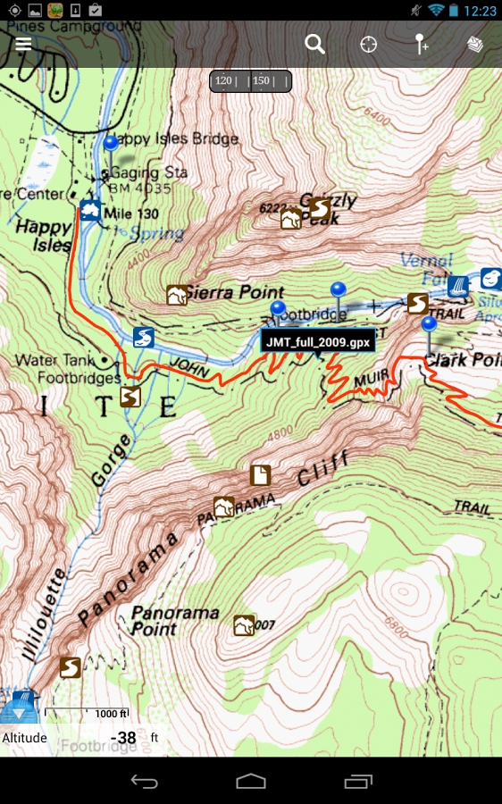
Google Maps Waze Gaia GPS

