Slide 1

PWR Act
Transitional Math
Kathleen Almy
Illinois Director for Transitional Math
Center for P20 Engagement
Northern Illinois University kalmy@niu.edu http://www2.iccb.org/iltransitionalmath
Presented by Amy Jo Clemens at the
67th Annual Western Illinois University
Mathematics Teachers' Conference (2018)

Slide 2
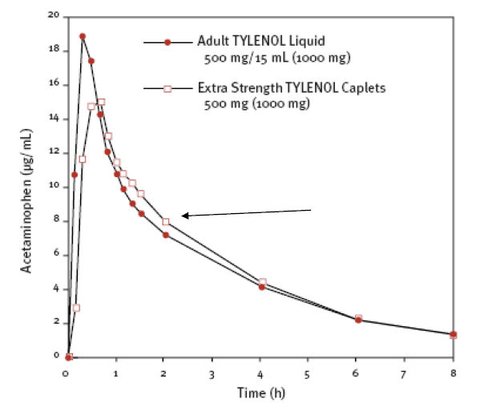
Which Tylenol Product Should You Use and Why?

Slide 3
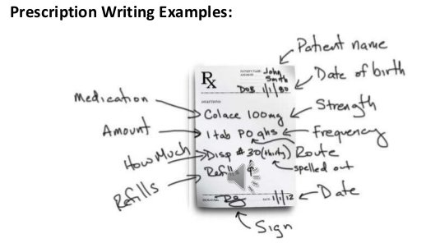
Is the Dosage Prescribed Safe?
A doctor orders dicloxacillin sodium 125 mg p.o. q.6.h. for a child who weighs 55 lb. The recommended dosage of dicloxacillin sodium for children weighing less than 40 kg is 12.5 to 25 mg/kg/day p.o. in equally divided doses q.6.h for moderate to severe infections.
Abbreviation definitions
p.o. – medication is taken orally
q.6.h. – frequency of medication taken (every 6 hours in this case)

Slide 4
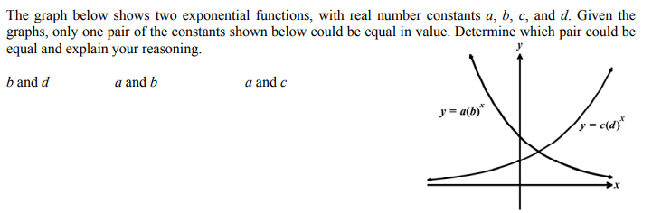
Complete your study, then summarize your findings in a report that you will submit to your supervisor.
Source: eMathinstruction
Stacks of Cups Problem
You are the package design director for a paper products company that has decided to introduce different-sized paper cups in the general shape shown below as a new product line. Your design team has been given the assignment of designing a cardboard carton that could be used to package the cups for sale. Your supervisor has given you the following requirements.
All faces of the carton are to be rectangular.
The square base should be just large enough to accommodate a single stack of cups.
The height of your carton should be given as a function of the maximum number of cups it will hold, since the marketing director has not yet
determined the number of cups that would be best to include for optimum sales.
All measurements should be given in metric units, preferably centimeters, since the company is an international one.
The expense of constructing the container should not be a factor in your proposal.
Since this is a new product for the team, you decide to study actual stacks of cups to help you discover which features of the cup affect the height of the stack. To do this, the team uses two types of plastic cups that were found around your office. Complete your study, then summarize your findings in a report that you will submit to your supervisor.
Source: The Pacesetter Curriculum, College Board
NOTE: This is the problem statement. In the Pacesetter Curriculum activity, many additional questions and problems related to the stacks of cups are included.

Slide 5
Postsecondary and Workforce Readiness Act (PWR Act)
  Public Act 99-0674 (HB 5729); signed by Governor on 7/29/16
Postsecondary and Career Expectations (PaCE)
Pilot of Competency-based High School Graduation Requirements
College and Career Pathway Endorsements on High School Diplomas
Transitional Math Courses
  4th year high school math courses designed to smooth transition to college and reduce remediation rates
  Not dual credit or AP courses
  Not for college credit

Slide 6
Transitional Math Courses Overview
Comprised of 3 pathways related to career pathways (meta majors):
College Algebra, QL/Statistics, and Technical Math
High school courses designed to provide guaranteed placement at IL community colleges (without a placement test)
Developed and administered through high school and college partnerships
Portability beyond local colleges when they meet statewide criteria
Provides schools flexibility with implementation
Statewide scaling over next 4-5 years
Work in conjunction with co-requisite redesigns
Align with the Common Core/Illinois Learning Standards

Slide 7
Why?

Slide 8

9th – 11th grade
Freshman year of college
Satisfying graduation requirements ≠ College readiness as measured by 1 test

Slide 9
9th – 11th grade
Freshman year of college
Placement tests underplaces many students
End up in remedial classes focused on college algebra prep
Only 10 – 11% make it through a credit bearing course eventually

Slide 10
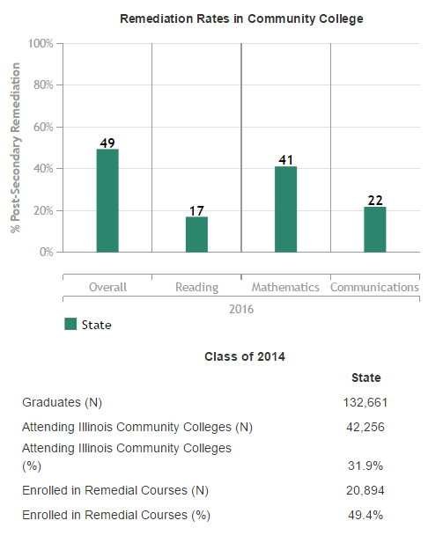
Source:
Illinois Report Card

Slide 11
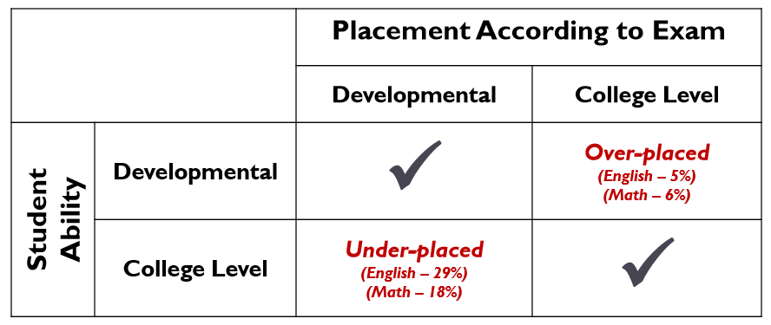
Assessment and Placement Research
By: Clive Belfield & Peter M. Crosta — February 2012
New York: Community College Research Center, Teachers College, Columbia University
Placement Tests: Accuplacer and Compass
Notes:
This paper uses student-level data from a statewide community college system to examine the validity of placement tests and high school information in predicting course grades and college performance. It considers the ACCUPLACER and COMPASS placement tests.
The authors find that placement tests do not yield strong predictions of how students will perform in college. Placement test scores are positively—but weakly—associated with college grade point average (GPA). The correlation disappears when high school GPA is controlled for.
In contrast, high school GPAs are useful for predicting many aspects of students’ college performance. High school GPA has a strong association with college GPA…and with college credit accumulation. A student whose high school GPA is one grade higher will have accumulate approximately four extra credits per semester.
The authors also calculate accuracy rates and four validity metrics for placement tests. They find high “severe” error rates using the placement test cutoffs. The severe error rate for English is 27 to 33 percent; i.e., three out of every ten students is severely misassigned. For math, the severe error rates are lower but still nontrivial. Using high school GPA instead of placement tests reduces the severe error rates by half across both English and math.

Slide 12

Current transitional math courses
Some transitional math courses exist in IL as a natural evolution of college developmental math reform. These are done with local partnerships and grants
Issues: Not at scale, inconsistent approach, no portability

Slide 13

PWR Act Transitional math
Use multiple measures to determine college readiness
Address issues before college (in senior year) when it is less punitive and expensive
Provides a different experience than traditional developmental math – contextualized problems that combine many concepts

Slide 14
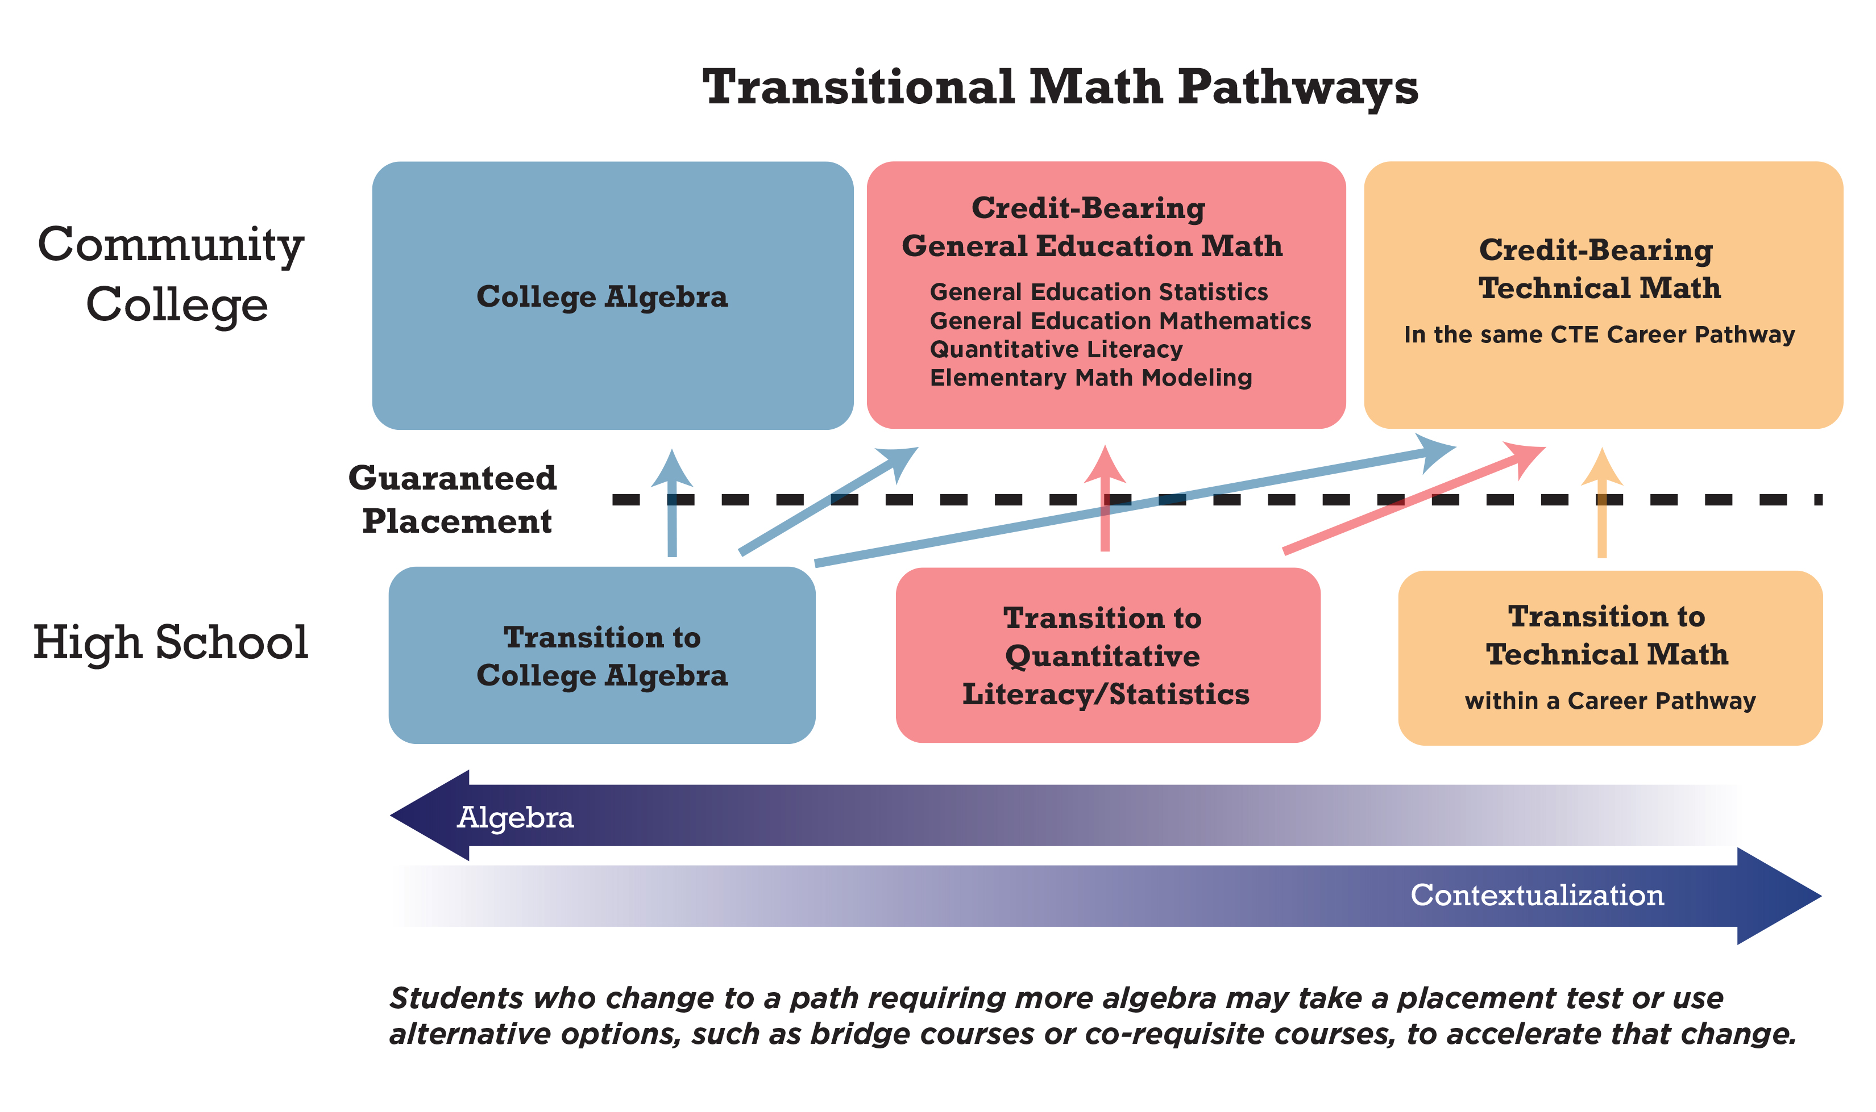
Rethinking Math: 12th Grade to 1st Year College

Slide 15
Transitional Math Courses &
Policy Development
  Includes administration, faculty, policy experts, and agency personnel at the K-12, community college, and university levels
  Works on policies for entrance, exit, and portability
Statewide Panel
Faculty who are create competencies to define required content and approach of the courses
College Algebra
QL/Statistics
Technical Math

Slide 16
Transitional Math Logistics
Students must have met graduation requirement to take transitional math
Placement lasts 18 months after receiving it
Students do not have to take a placement test at the end of the course
  Schools can use placement tests as a component of assessment of courses
Courses will be transcripted at high school and college level*
Courses can be one semester or one year
Portability of courses to be determined at the state level
  Verify competencies and policies are met
  Similar to IAI

Slide 17
Factors critical to transitional math success
MOU establishing expectations that have been agreed upon by HS and CC
Training and ongoing support for teachers
Comprehensive advising approach
Evaluation and improvement of courses over time
  Requires a working relationship between HS and CC

Slide 18
Junior year: determine college readiness
*Students who are deemed college ready can take TM if they choose.
11th Grade Projected Readiness Determination
Use statewide criteria
Based on each student’s postsecondary math pathway
Metrics: GPA, course grades, standardized test scores
Not Projected Ready
Transitional math co-developed by
school district and community college*
Projected Ready
Student decides whether to
take math in 12th grade
Successful Completion of Transitional Math
Placed in college-level math course in applicable math pathway
Unsuccessful Completion or
No Math Senior Year
Subject to general placement processes
Successful Completion of Rigorous Math in 12th Grade
Placed in college-level math course in applicable math pathway

Slide 19
Will they all pass?
No.
Pass rates in pilots are often in the 70 – 85% range
Often higher than colleges for many logistical reasons
Students who don’t earn a C or better will be subject to placement at colleges
Bridge courses
Co-requisite courses

Slide 20
Why would a student want to take a transitional math course?
Avoid a placement test
Save time and money when going to college
Address the math weaknesses they have in interesting problems
Students get to “do math”
  See how math comes together and applies to their lives, work, and courses they have identified is of interest to them (through career and college planning)
  Designed for seniors to give them a different experience their last year (from first 3 years or traditional dev math)
  Integrate contextualized learning, problem solving, and college and career readiness
  Focus on complex problems, not just complex procedures

Slide 21
Readiness from a college math perspective: a working knowledge of content
Students can:
Read and think critically
Use mathematical skills
Use technology
Solve problems with words
CONNECT
APPLY
RETAIN

Slide 22
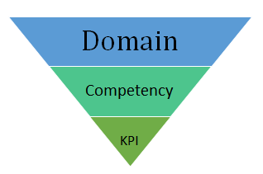
Competencies vs. Standards
Competencies are broad learning goals for a mathematical area called a domain
Competencies illustrate how a student can integrate and apply skills in context for a domain
Key performance indicators (KPI’s) are more like standards
  Emphasize higher elements of Bloom’s taxonomy
Competencies define a core foundation with the ability to supplement for additional specific fields
*See transitional math website
http://www2.iccb.org/iltransitionalmath/

Slide 23
Continuing the work of the Common Core
Competencies align with CC/ILS
Combine many skills in ways they were taught in CC but into bigger problems
  Emphasize problems, not just exercises
Use contexts relevant to a 17-year-old
Emphasize content and process

Slide 24
Transition to Technical Math
Supports a smooth transition to a particular technical field and its math requirement
Outcome course goal:
Use numeracy in a technical math course
TM course emphasis:
Using numeric skills easily in a variety of applied situations
A doctor orders dicloxacillin sodium 125 mg p.o. q.6.h. for a child who weighs 55 lb. The recommended dosage of dicloxacillin sodium for children weighing less than 40 kg is 12.5 to 25 mg/kg/day p.o. in equally divided doses q.6.h for moderate to severe infections. Is the dosage safe?
Abbreviation definitions
p.o. – medication is taken orally
q.6.h. – frequency of medication taken (every 6 hours in this case)

Slide 25
Transition to Quantitative Literacy and Statistics
Aligns to non-STEM dev math courses like math literacy;
Default pathway
Outcome course goal:
Use numeracy and basic algebra skills in general education math courses
TM course emphasis:
Reading word-based problems and determining the needed algebraic and numeric concepts

Slide 26
Transition to College Algebra
Develops and/or improves Algebra 2 skills while working in function contexts
Can be used as an Algebra 2 course or after one
Emphasis on problem solving, often in context, but also in non-contextualized situations
Outcome course goal:
Use algebra 2 skills and concepts successfully in a College Algebra class
TM course emphasis:
Transition from procedural algebra to graphical representations

Slide 27
Implementation
ICCB supporting statewide implementation of transitional math through grants and staffing
Draft policies and competencies in the three math pathways being finalized
Pilot activities occurring in 20+ community college districts
Outreach occurring with 4-year universities to obtain acceptance of transitional math courses
A tracking/assessment process will be developed

Slide 28
Implementation
Phase in of new courses
  Fall 2018 – develop partnerships and MOU’s based on course outcomes; existing courses can be used
  Fall 2019 – pilot of first PWR TM approved courses with resources available from state
State-level creation of example materials, MOU’s, and curriculum maps
Increased outreach through summits, webinars, professional development, websites, email, conference presentations, statewide convenings, and more

Slide 29
Scaling Transitional Math:
Colleges or high schools implementing, or planning to implement TM
Community college districts:
  2017: 24 out of 39 (62%)
  2018: 25 out of 39 (64%)
  2019: 27 out of 39 (69%)
High Schools:
  2017: 74 out of 721 (10%)
  2018: 134 out of 721 (19%)
  2019: 208 out of 721 (29%)

Slide 30
Policies and Competencies Timeline
July 2016
PWR Act signed into law
August 2017
Subcommittees review competencies
Oct 23 – Jan 15, 2018
Public commenting on policies and comps; informational presentations
Spring 2018
Competencies voted on by state agencies
Subcommittees and statewide panel begin work
March 2017
Statewide panel reviews policies, comps
Projected Readiness workgroup begins work
October 2017
Statewide panel reviewed comments and PR benchmark
Feb 2018
Sample MOUs, course outlines, materials created; implementation plan created
Mar – Dec 2018
By June 2018, polices and competencies must be approved.
By June 2019, ICCB and ISBE establish a statewide implementation plan.

Slide 31
For more information
Contact Kathleen Almy
kalmy@niu.edu
Website: http://www2.iccb.org/iltransitionalmath/
Documents
FAQ
Webinar recordings
PWR Act
pwract.org

